Slide 1


IST 782: APPLIED DATA SCIENCE PORTFOLIO
SYRACUSE UNIVERSITY
Name - Sukhad Dnyanesh Joshi
Portfolio Presentation
Github- https://github.com/SukhadJoshi/MS-ADS-Portfolio_Sukhad-Dnyanesh-Joshi

Slide 2
ABOUT ME
I am a Master’s student in Applied Data Science at Syracuse University, graduating in May 2025.My academic background includes strong foundations in Machine Learning, Predictive Modeling, and Artificial Intelligence.I have hands-on experience in Python, R, SQL, and working with real-world datasets to drive business insights.
I am passionate about using data science to solve problems across business, healthcare, and technology sectors. In this presentation, I will walk you through key projects that demonstrate my learning and skills development.

Slide 3
PROGRAM LEARNING GOALS
Collect, store, and access data using appropriate data technologies.
Generate actionable insights across different industries and problem domains.
Apply data visualization and predictive modeling to support decision-making.
Develop solutions using programming languages such as Python and R.
Communicate technical results clearly to a range of audiences, from technical teams to business stakeholders.
Apply ethical principles in designing and evaluating data models (fairness, transparency, privacy).

Slide 4
IST 691- PROJECT 1: PORTFOLIO OPTIMIZATION USING BIDIRECTIONAL CNN-LSTM WITH ATTENTION MECHANISM
Overview:-
Objective:
Improve stock price prediction accuracy for better portfolio optimization strategies.
Approach:
Built a hybrid model combining Convolutional Neural Networks (CNN) for feature extraction and Bidirectional LSTM (Long Short-Term Memory) networks for sequential data learning, integrated with an Attention mechanism.
Data Source:
Stock market data collected using Yahoo Finance API.
Key Techniques:
Time-series forecasting, Deep Learning, Attention Mechanisms.

Slide 5
Key Outcomes & Skills:-
Achievements:
Outperformed traditional SARIMA models with an MSE of 6.42. Visualized stock trends using candlestick and line charts to interpret results.
Skills Developed:
Deep learning model building, time-series analysis, financial data handling, hyperparameter tuning.
Challenges:
Handling high volatility in financial time series data.
Solutions:
Used feature engineering (moving averages, volatility measures) and tuning Bi-LSTM parameters to stabilize model performance.

Slide 6
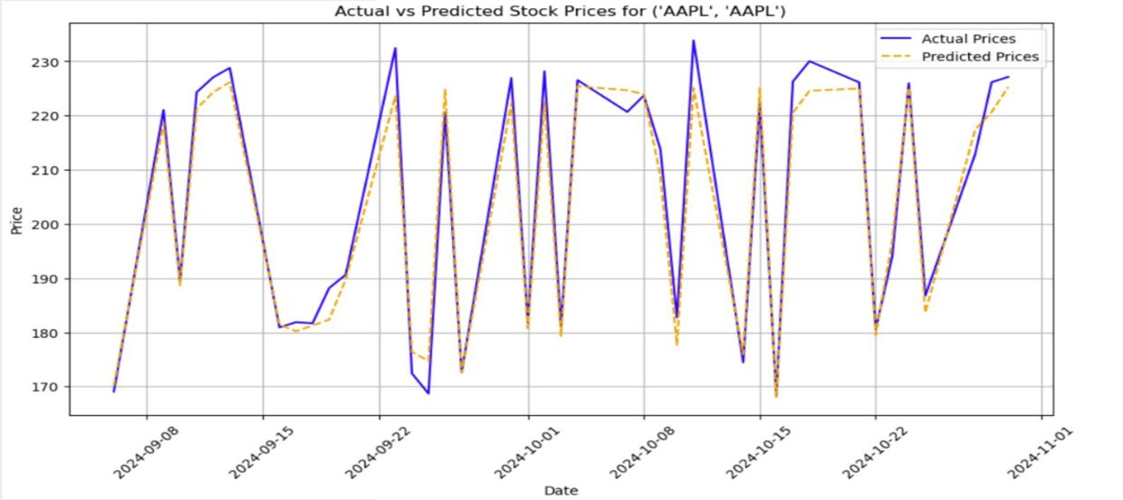
Stock Price Prediction: CNN-LSTM Model Performance
The CNN-LSTM model closely tracked the real price movements, outperforming traditional models like SARIMA in handling volatility

Slide 7
IST 652- PROJECT 2: IMPACT OF WEATHER CONDITIONS ON MOTOR VEHICLE COLLISIONS IN NYC
Overview:-
Objective:
Analyze how adverse weather conditions affect the severity of motor vehicle collisions.
Approach:
Conducted Exploratory Data Analysis (EDA) on over 100,000 collision records and built Logistic Regression and Decision Tree models to predict accident severity based on weather variables.
Data Source:
NYC Open Data (Motor Vehicle Collisions dataset) and weather datasets from meteostat package.

Slide 8
Key Outcomes & Skills:-
Achievements:
Identified significant correlations between bad weather (rain, snow) and higher accident severity. Created interactive visualizations to communicate findings to policymakers.
Skills Developed:
EDA, statistical modeling, predictive modeling, data integration.
Challenges:
Severe class imbalance with fewer high-severity accidents.
Solutions:
Applied SMOTE (Synthetic Minority Over-sampling Technique) to balance the dataset for better model training.

Slide 9
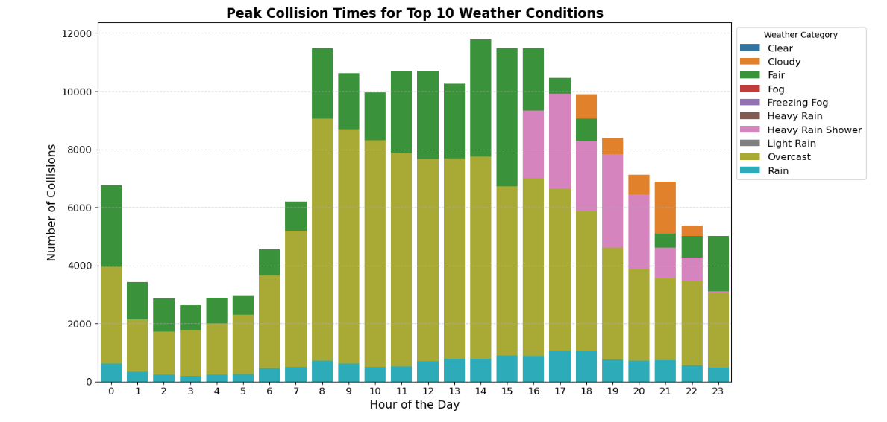
Impact of Weather Conditions on Collision Timing
The analysis shows that adverse weather conditions such as rain, fog, and heavy rain showers contributed significantly to higher collision rates during peak traffic hours.

Slide 10
IST 707- PROJECT 3: CREDIBILITY DETECTION OF HEALTH WEB BLOGS USING EXPLAINABLE AI
Overview:-
Objective:
Build machine learning models to detect the credibility of online health blogs and make model decisions interpretable.
Approach:
Used Random Forest and XGBoost classifiers and integrated SHAP values to explain predictions.
Data Source:
Collected 1,000 blogs and evaluated features like website authority, author reputation, and user engagement.

Slide 11
Key Outcomes & Skills:-
Achievements:
Achieved 85% accuracy in credibility prediction. Increased model transparency using SHAP value visualizations.
Skills Developed:
Model explainability (SHAP), classification modeling, ethical AI applications.
Challenges:
Finding the fake blogs and distinguishing them from real ones was a hard task.
Solutions:
Integrated SHAP visualizations to clearly explain feature importance and model decisions.

Slide 12
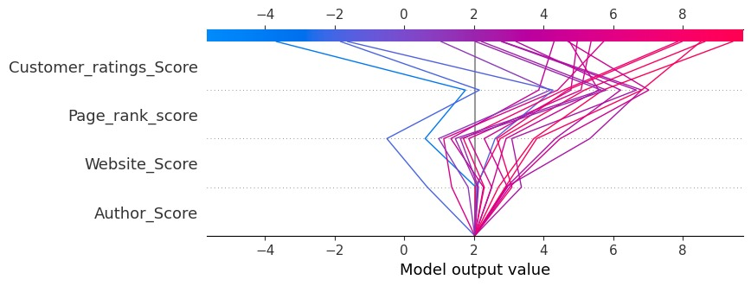
Feature Importance for Health Blog Credibility Prediction
The model identified Customer Ratings Score, Page Rank Score, Website Score, and Author Score as the most influential factors in determining the credibility of health blogs.

Slide 13
IST 664 - PROJECT 4: SENTIMENT CLASSIFICATION OF MOVIE REVIEWS
Overview:-
Objective:
Build a sentiment analysis model to classify movie reviews as positive or negative.
Approach:
Preprocessed over 10,000 movie reviews and engineered features using LIWC categories, Part-of-Speech tagging, and traditional unigrams/bigrams.
Data Source:
Kaggle datasets and custom-processed movie review corpora.

Slide 14
Key Outcomes & Skills:-
Achievements:
Successfully built classification pipelines with multiple feature sets.
Skills Developed:
NLP preprocessing, feature engineering (LIWC, POS, Sentiment Lexicons), machine learning model comparison.
Challenges:
Managing sparse, high-dimensional text datasets.
Solutions:
Applied feature selection and dimension reduction techniques to improve model generalizability.

Slide 15
Feature Engineering: Sentiment Lexicons
Integrated external sentiment lexicons to enhance feature extraction:
MPQA Subjectivity Lexicon: Tagged words by subjectivity and polarity.
Positive and Negative Word Lists: Focused on emotionally charged words.
OpinionFinder Subjectivity Lexicon: Classified words as strong/weak subjective indicators.
Created customized filtered datasets using unigram, bigram, and combo features.
Improved model focus on sentiment-driven words, enhancing overall classification performance.

Slide 16
IST 687 - PROJECT 5: PREDICTIVE ENERGY MODELING
Overview:-
Objective:
Predict daily energy consumption using building features and environmental variables.
Approach:
Built a Multiple Linear Regression model and developed an interactive Shiny app to forecast energy usage dynamically.
Data Source:
Dataset containing over 10,000 observations with 171 variables.

Slide 17
Key Outcomes & Skills:-
Achievements:
Explained over 50% variance in energy usage through modeling. Created an interactive web dashboard for dynamic energy forecasting
Skills Developed:
Regression modeling, feature selection (PCA), dashboard development (Shiny in R).
Challenges:
Identifying the most relevant predictors among many variables.
Solutions:
Applied Principal Component Analysis (PCA) to reduce dimensionality and improve model efficiency.

Slide 18
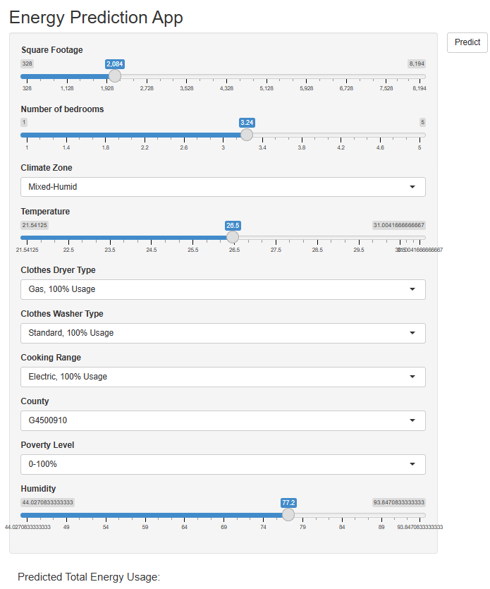
Energy Demand Prediction: Shiny App Interface
The application allows users to input household characteristics and environmental conditions to predict total energy usage. It demonstrates how machine learning models can be deployed into user-friendly web interfaces

Slide 19
SKILLS DEVELOPED
Technical Skills:
Python (Pandas, NumPy, Scikit-Learn, TensorFlow)
R programming (Shiny, Regression Modeling)
Natural Language Processing (NLP) techniques
Explainable AI tools like SHAP
Data Visualization and Dashboard Development
Professional Skills:
Critical thinking and structured problem-solving
Communicating technical results clearly to diverse audiences
Managing end-to-end data science project pipelines

Slide 20
SUMMARY
Completed five major projects across finance, public safety, healthcare, media, and energy domains.
Applied machine learning, deep learning, and natural language processing techniques to solve real problems.
Developed interactive tools like Shiny Apps and dashboards for accessible decision-making.
Strengthened skills in data modeling, visualization, ethical AI practices, and technical communication.
Ready to apply data science techniques responsibly in professional environments to make an impact.

Slide 21
CHALLENGES FACED-
WORKING WITH MESSY AND INCOMPLETE REAL-WORLD DATASETS WAS CHALLENGING AND OFTEN REQUIRED A LOT OF CLEANING AND PREPROCESSING.
DEALING WITH UNBALANCED DATASETS, ESPECIALLY IN ACCIDENT SEVERITY PREDICTION, MADE IT HARDER TO TRAIN RELIABLE MODELS.
MAKING MACHINE LEARNING MODELS EXPLAINABLE AND EASY TO UNDERSTAND WAS SOMETIMES DIFFICULT BUT VERY IMPORTANT.

Slide 22
FUTURE CAREER GOALS-
I WANT TO KEEP LEARNING AND SPECIALIZE MORE IN ARTIFICIAL INTELLIGENCE AND HELP BUSINESSES, ORGANIZATIONS USING MY SKILLS.
I AM EXCITED TO APPLY DATA SCIENCE TECHNIQUES TO SOLVE REAL-WORLD PROBLEMS IN AREAS LIKE BUSINESS AND HEALTHCARE.
I WILL CONTINUE TO STAY UPDATED WITH THE LATEST TECHNOLOGIES AND TRENDS TO KEEP GROWING AS A DATA SCIENCE PROFESSIONAL.

Slide 23


CONCLUSION-
In my master’s journey, I learned how to apply my skills in real situations. Working on different types of problems made me a better thinker and problem solver. I’m excited to keep learning and use these skills and technologies in my future career.
THANK YOU

